Slide 1



PREDICTING DRUG PERSISTENCY USING MACHINE LEARNING
A data-driven approach to understanding patient adherence patterns and improving treatment outcomes in pharmaceutical care
PHARMAPREDICTORS
DATA SCIENCE PROJECT
CLASSIFICATION ANALYSIS
Project Lead: Radhika Diyora
Institution: IU International
Location: Germany
Email: radhikadiyora2023@gmail.com
Problem Type: Binary Classification
Industry: Pharmaceutical Analytics

Slide 2



BUSINESS CONTEXT
UNDERSTANDING THE PERSISTENCY CHALLENGE
Pharmaceutical companies face a critical challenge in maintaining patient persistency with prescribed medications. When patients discontinue treatment prematurely, it creates a cascading effect of negative outcomes that impact both clinical effectiveness and business performance.
PATIENT HEALTH IMPACT
FINANCIAL CONSEQUENCES
Interrupted treatment cycles lead to suboptimal therapeutic outcomes, disease progression, and preventable health complications
Non-persistent patients represent significant revenue losses and reduced return on investment for drug development
TREATMENT EFFICACY
Incomplete medication regimens compromise clinical trial results and real-world effectiveness data
ABC Pharma's Objective: Leverage advanced analytics and machine learning to identify key factors driving persistency and predict patient behavior patterns early in the treatment journey

Slide 3




DEFINING THE MACHINE LEARNING PROBLEM
PROBLEM FRAMEWORK
This project addresses a binary classification challenge, where we predict whether patients will maintain their prescribed medication regimen over time.
TARGET VARIABLE
PRIMARY OBJECTIVES
SUCCESS METRICS
Persistency_Flag
Build predictive model for persistency classification
Model accuracy and precision
1 = Persistent patient (completed treatment)
Recall for at-risk patients
Identify key clinical and behavioral drivers
ROC-AUC score for classification quality
0 = Non-persistent patient (discontinued early)
Generate actionable insights for intervention strategies
Business interpretability

Slide 4


DATA FOUNDATION
COMPREHENSIVE DATASET OVERVIEW
The analysis leverages a carefully curated dataset encompassing patient demographics, clinical indicators, and treatment adherence patterns. This multi-dimensional approach enables comprehensive understanding of factors influencing medication persistency.
200
26
PATIENT RECORDS
FEATURE VARIABLES
Complete treatment histories analyzed
Spanning demographics, clinical, and behavioral data
34
ENCODED FEATURES
After preprocessing and transformation
01
02
DEMOGRAPHICS
CLINICAL FACTORS
Age, gender, race, geographic region
T-Score, risk segment, fracture history
03
04
TREATMENT BEHAVIOR
ADHERENCE METRICS
Dexa scans, injectable experience, therapy engagement
Compliance scores, refill patterns, treatment continuity

Slide 5

DATA QUALITY & DISTRIBUTION ANALYSIS
EXCEPTIONAL DATA QUALITY
BALANCED TARGET DISTRIBUTION
The dataset demonstrated zero missing values across all 26 features, eliminating the need for imputation strategies and ensuring robust model training without data quality compromises.
Class distribution shows healthy balance with 110 persistent patients (55%) and 90 non-persistent patients (45%), minimizing class imbalance concerns and supporting fair model evaluation.
DATASET READINESS
Complete records with no missing data
Consistent data types across features
No outliers requiring treatment
Ready for immediate modeling
Persistent
Non-Persistent

Slide 6

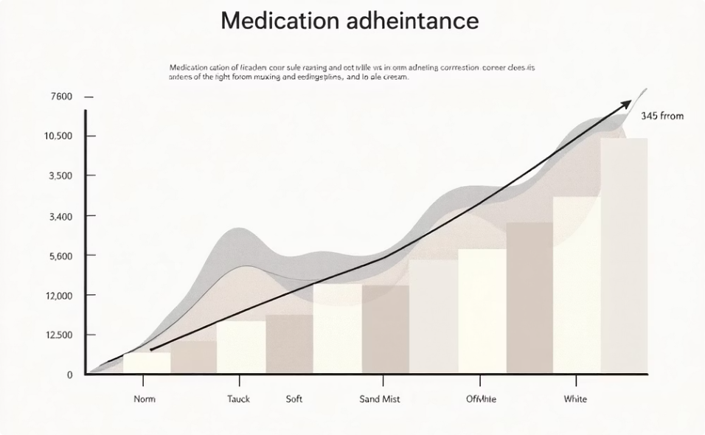


EXPLORATORY ANALYSIS
KEY INSIGHTS FROM DATA EXPLORATION
Comprehensive exploratory data analysis revealed critical patterns and relationships between patient characteristics and treatment persistency, guiding feature selection and model development strategies.
ADHERENCE SCORE IMPACT
CLINICAL ENGAGEMENT
INJECTABLE EXPERIENCE
Medication adherence scores demonstrated the strongest positive correlation with persistency outcomes across all patient cohorts
Patients receiving Dexa scans during therapy showed significantly higher persistency rates, indicating value of monitoring
Prior experience with injectable medications correlated with improved treatment continuation and compliance patterns
Clinical risk indicators and T-Score improvements emerged as powerful predictive signals, revealing that patients with measurable health progress demonstrate stronger commitment to treatment protocols.

Slide 7
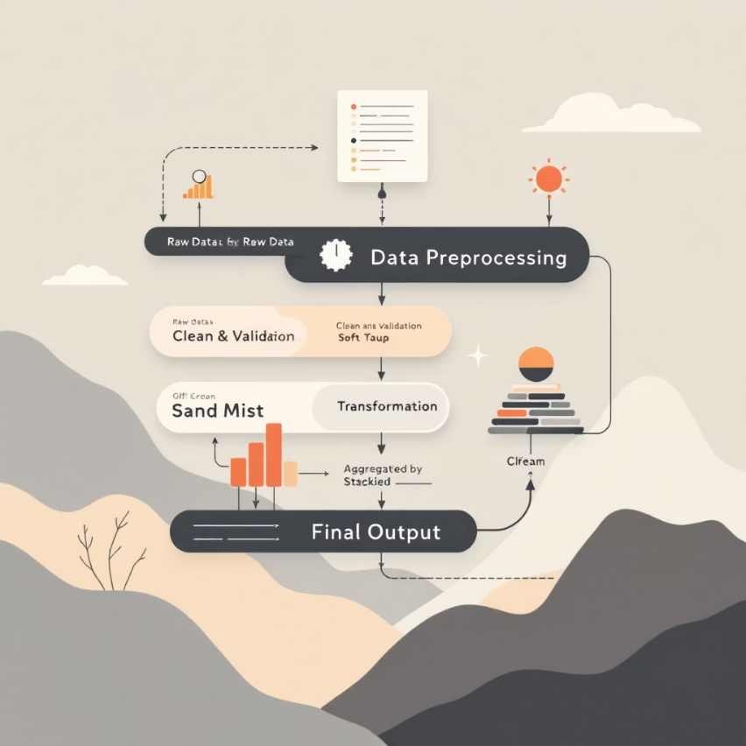






FEATURE ENGINEERING & DATA PREPARATION
Transforming raw patient data into model-ready features required systematic preprocessing to ensure optimal algorithm performance while maintaining interpretability for clinical stakeholders.
ENCODING
SCALING
SELECTION
Categorical variables converted using one-hot encoding to preserve information without introducing ordinal bias
Numerical features normalized where needed to ensure consistent ranges across algorithms
Patient identifiers excluded from training to prevent data leakage and overfitting
TRAINING SET
TEST SET
FEATURE SPACE
160 records (80%)
40 records (20%)
34 dimensions
Used for model learning and parameter optimization
Reserved for unbiased performance evaluation
Final engineered feature matrix after transformation

Slide 8



MODEL DEVELOPMENT
MACHINE LEARNING MODEL SELECTION
We implemented two complementary classification algorithms, each selected for specific strengths in interpretability, performance, and suitability for healthcare applications with limited sample sizes.
1
2
LOGISTIC REGRESSION
RANDOM FOREST CLASSIFIER
Baseline Interpretable Model
Non-Linear Pattern Recognition
Linear decision boundaries for clear understanding
Captures complex interactions between variables
Direct coefficient interpretation for clinical insights
Ensemble approach reduces overfitting risk
Efficient training on small-to-medium datasets
Handles mixed feature types effectively
Excellent for identifying feature importance
Built-in feature importance rankings
Strategic Rationale: These algorithms balance predictive power with business explainability—critical for gaining stakeholder trust and enabling actionable interventions in clinical settings.

Slide 9





MODEL PERFORMANCE EVALUATION
Comprehensive evaluation across multiple metrics provides nuanced understanding of model strengths and appropriate deployment contexts for clinical decision support.
LOGISTIC REGRESSION RESULTS
RANDOM FOREST RESULTS
52.5%
50%
ACCURACY
ACCURACY
Overall classification correctness
Baseline performance
55.6%
51.8%
PRECISION
ROC-AUC
Positive prediction reliability
Minimal separation capability
Performance Note: Random Forest showed limited improvement, suggesting linear relationships dominate this dataset
68.2%
RECALL
Persistent patient identification rate
ROC-AUC Score: 0.588 — Moderate discriminative ability above random chance
Winner: Logistic Regression outperformed on all key metrics, particularly excelling in recall—crucial for identifying at-risk patients who need intervention.

Slide 10




KEY FINDINGS
BUSINESS INSIGHTS & STRATEGIC RECOMMENDATIONS
ADHERENCE IS PARAMOUNT
CLINICAL ENGAGEMENT MATTERS
DEMOGRAPHICS SHOW LIMITED IMPACT
Medication adherence scores emerged as the single strongest predictor of persistency, suggesting that early adherence monitoring should be a primary intervention target for improving patient outcomes.
Traditional demographic factors alone prove to be weak predictors, reinforcing that behavioral and clinical engagement metrics provide superior predictive value for intervention strategies.
Active clinical monitoring through Dexa scans and injectable medication experience correlates strongly with treatment continuation, indicating that engaged patient-provider relationships drive persistency.
TECHNICAL RECOMMENDATIONS & FUTURE DIRECTIONS
MODEL DEPLOYMENT
DATA CHALLENGES
ENHANCEMENT OPPORTUNITIES
Deploy Logistic Regression as primary model
Limited sample size (200 patients)
Absence of longitudinal tracking
Incorporate time-series medication data
Explore Gradient Boosting for enhancement
No prescription refill history
Add pharmacy refill patterns
Develop real-time API for clinical integration
Integrate social determinants of health

